Slide 1
DASC 5301-002
Classification
Dr Subharag Sarkar
Fall 2023
Slides Courtesy - Rózsa Záruba

Slide 2
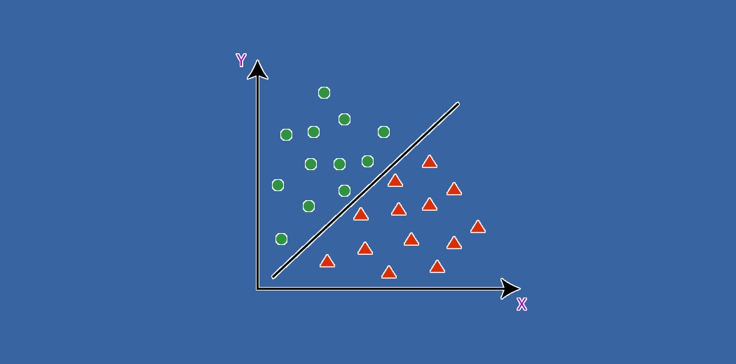

Slide 3
Introduction
Machine Learning tasks are mainly divided into three types:
Supervised Learning — In Supervised learning, the model is first trained using a Training set(it contains input-expected output pairs). This trained model can be later used to predict output for any unknown input.
Unsupervised Learning — In unsupervised learning, the model by itself tries to identify patterns in the training set.
Reinforcement Learning — This is an altogether different type. Better not to talk about it.

Slide 4
Basic Concepts
Classification and Regression both belong to Supervised Learning, but the former is applied where the outcome is finite while the latter is for infinite possible values of outcome (e.g. predict $ value of the purchase).
The normal distribution is the familiar bell-shaped distribution of a continuous variable. This is a natural spread of the values a parameter takes typically.

Slide 5
Basic Concepts
Given that predictors may carry different ranges of values e.g. human weight may be up to 150 (kgs), but the typical height is only till 6 (ft); the values need scaling (around the respective mean) to make them comparable.
Collinearity is when 2 or more predictors are related i.e. their values move together.
Outliers are exceptional values of a predictor, which may or may not be true.

Slide 6
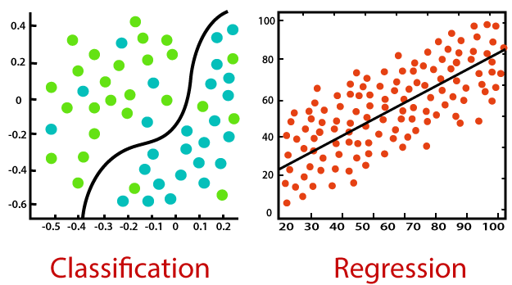
Basic Concepts

Slide 7
What is Classification?
Classification is defined as the process of recognition, understanding, and grouping of objects and ideas into preset categories a.k.a “sub-populations.”
With the help of these pre-categorized training datasets, classification in machine learning programs leverage a wide range of algorithms to classify future datasets into respective and relevant categories.

Slide 8
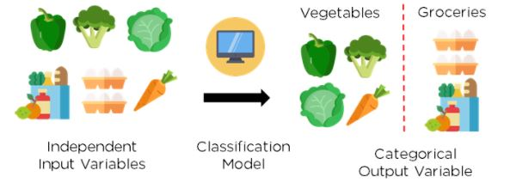
What is Classification?
Classification is a form of “pattern recognition”.
Here, classification algorithms applied to the training data find the same pattern (similar number sequences, words or sentiments, and the like) in future data sets.

Slide 9
Classification Challenges
Some types of Classification challenges are :
Classifying emails as spam or not
Classify a given handwritten character to be either a known character or not
Classify recent user behavior as churn or not…

Slide 10
Type of Classification
Binary classification
Multi-Class Classification
Multi-Label Classification
Imbalanced Classification

Slide 11
Binary Classification

Slide 12
Binary Classification
A binary classification refers to those tasks which can give either of any two class labels as the output.
Generally, one is considered as the normal state and the other is considered to be the abnormal state.:
Email Spam detection: Normal State – Not Spam, Abnormal State – Spam
Conversion prediction: Normal State – Not churned, Abnormal State – Churn
Conversion Prediction: Normal State – Bought an item, Abnormal State – Not bought an item

Slide 13
Binary Classification
The most popular algorithms which are used for binary classification are :
K-Nearest Neighbors
Logistic Regression
Support Vector Machine
Decision Trees
Naive Bayes
Notes:
some algorithms were specifically designed for the purpose of binary classification and natively do not support more than two types of class. Some examples of such algorithms are Support Vector Machines and Logistic Regression.

Slide 14
Multi-Class Classification

Slide 15
Multi-Class Classification
These types of classification problems have no fixed two labels but can have any number of labels. Some popular examples of multi-class classification are :
Plant Species Classification
Face Classification
Optical Character recognition

Slide 16
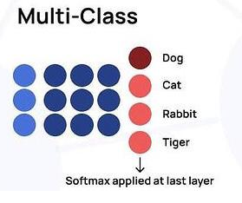
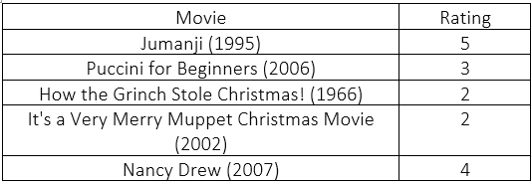
Multi-Class Classification

Slide 17
Multi-Class Classification
The most common algorithms which are used for Multi-Class Classification are :
K-Nearest Neighbors
Naive Bayes
Decision trees
Gradient Boosting
Random Forest

Slide 18
Multi-Class Classification
You can also use the algorithms for Binary Classification here on a basis of either one class vs all the other classes, also known as one-vs-rest, or one model for a pair of classes in the model which is also known as one-vs-one.
One Vs Rest – The main task here is to fit one model for each class which will be versus all the other classes
One Vs One – The main task here is to define a binary model for every pair of classes.

Slide 19
Multi Label Classification

Slide 20
Multi-Label Classification
In multi-label Classification, we refer to those specific classification tasks where we need to assign two or more specific class labels that could be predicted for each example.
A basic example can be photo classification where a single photo can have multiple objects in it like a dog or an apple and etcetera.
The main difference is the ability to predict multiple labels and not just one.

Slide 21
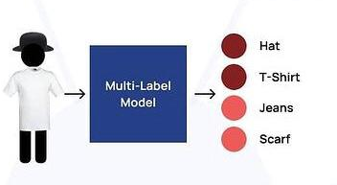
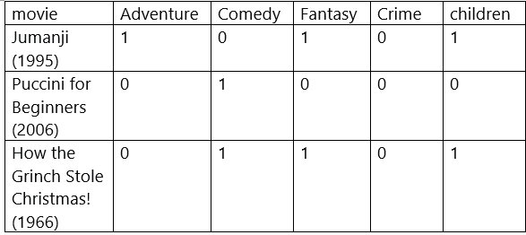
Multi-Label Classification

Slide 22
Multi-Label Classification
The common algorithms used here are :
Multi-label Random Forests
Multi-label Decision trees
Multi-label Gradient Boosting
One more approach is to use a separate classification algorithm for the label prediction for each and every type of class.
Notes:
Start -> You cannot use a binary classification model or a multi-class classification model for multi-label classification and you have to use a modified version of the algorithm to incorporate for multiple classes which can be possible and then to look for them all.
It becomes more challenging than a simple yes or no statement.

Slide 23
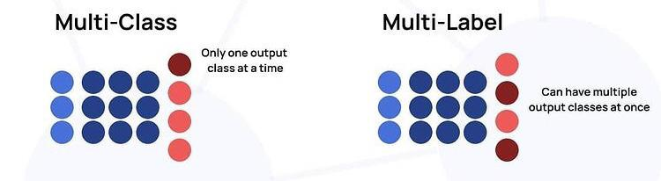
Multi-Class vs. Multi-label

Slide 24
Imbalanced Classification

Slide 25
Imbalanced Classification
An Imbalanced Classification refers to those tasks where the number of examples in each of the classes are unequally distributed.
Generally, imbalanced classification tasks are binary classification jobs where a major portion of the training dataset is of the normal class type and a minority of them belong to the abnormal class.

Slide 26
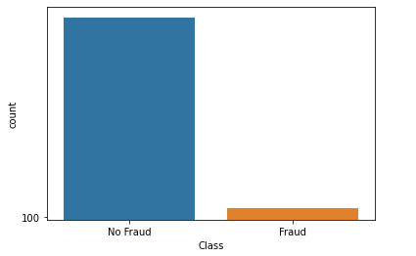
Imbalanced Classification
The most important examples of these use cases are :
Fraud Detection
Outlier Detection
Medical Diagnosis Test

Slide 27
Imbalanced Classification
Special modelling algorithms can be used to give more attention to the minority class when the model is being fitted on the training dataset which includes cost-sensitive machine learning models.
Especially for cases like :
Cost-Sensitive Logistic Regression
Cost-Sensitive Decision Trees
Cost-Sensitive Support Vector Machines

Slide 28
Classification Algorithms: A quick guide

Slide 29
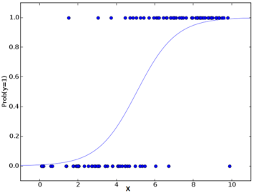
Logistic Regression
Logistic Regression utilizes the power of regression to do classification and has been doing so exceedingly well for several decades now, to remain amongst the most popular models.
One of the main reasons for the model’s success is its power of explainability i.e. calling-out the contribution of individual predictors, quantitatively.
Notes:
The algorithm is a popular choice in many natural language processing tasks e.g. toxic speech detection, topic classification, etc.

Slide 30
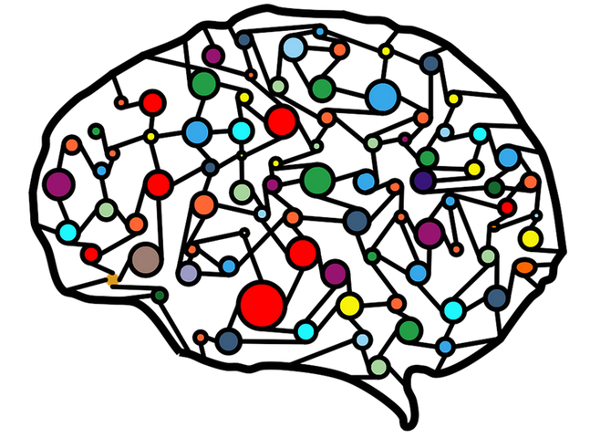
Artificial Neural Networks
Artificial Neural Networks (ANN), so-called as they try to mimic the human brain, are suitable for large and complex datasets.
Their structure comprises of layer(s) of intermediate nodes (similar to neurons) which are mapped together to the multiple inputs and the target output.

Slide 31
Artificial Neural Networks
It is a self-learning algorithm, in that it starts out with an initial (random) mapping and thereafter, iteratively self-adjusts the related weights to fine-tune to the desired output for all the records.
The multiple layers provide a deep learning capability to be able to extract higher-level features from the raw data.
The algorithm provides high prediction accuracy but needs to be scaled numeric features. It has wide applications in upcoming fields including Computer Vision, NLP, Speech Recognition, etc.

Slide 32
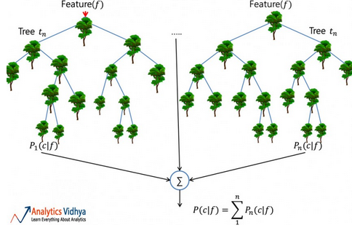
Random Forest
A Random Forest is a reliable ensemble of multiple Decision Trees (or CARTs); though more popular for classification, than regression applications.
Here, the individual trees are built via bagging (i.e. aggregation of bootstraps which are nothing but multiple train datasets created via sampling of records with replacement) and split using fewer features.
The resulting diverse forest of uncorrelated trees exhibits reduced variance; therefore, is more robust towards change in data and carries its prediction accuracy to new data.

Slide 33
Random Forest
However, the algorithm does not work well for datasets having a lots of outliers, something which needs addressing prior to the model building.
It has wide applications across Financial, Retail, Aeronautics, and many other domains.

Slide 34
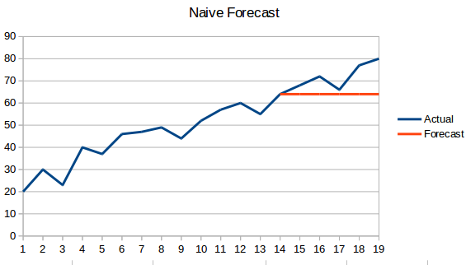
Naïve Bayes
This is the most commonly used algorithm to sift through spam emails!
It applies what is known as a posterior probability using Bayes Theorem to do the categorization on the unstructured data and makes a naïve assumption that the predictors are independent, which may not be true.
The model works well with a small training dataset, provided all the classes of the categorical predictor are present.

Slide 35
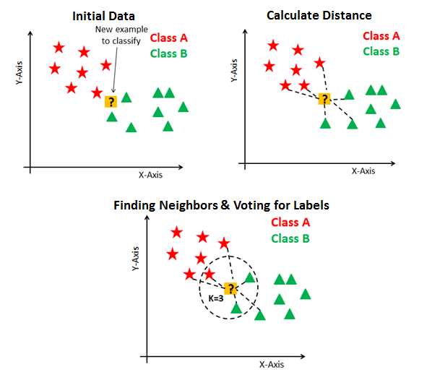
KNN
K-Nearest Neighbor (KNN) algorithm predicts based on the specified number (k) of the nearest neighboring data points.
Here, the pre-processing of the data is significant as it impacts the distance measurements directly.
Unlike others, the model does not have a mathematical formula, neither any descriptive ability.

Slide 36
KNN
Here, the parameter ‘k’ needs to be chosen wisely; as a value lower than optimal leads to bias, whereas a higher value impacts prediction accuracy.
It is a simple, fairly accurate model preferable mostly for smaller datasets, owing to huge computations involved on the continuous predictors.
At a simple level, KNN may be used in a bivariate predictor setting e.g. height and weight, to determine the gender given a sample.

Slide 37
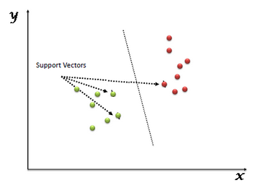
Support Vector Machine
“Support Vector Machine” (SVM) is a supervised machine learning algorithm that can be used for both classification or regression challenges.
However, it is mostly used in classification problems.
In the SVM algorithm, we plot each data item as a point in n-dimensional space (where n is a number of features you have) with the value of each feature being the value of a particular coordinate.

Slide 38
Support Vector Machine
Then, we perform classification by finding the hyper-plane that differentiates the two classes very well.
Support Vectors are simply the coordinates of individual observation.
The SVM classifier is a frontier that best segregates the two classes (hyper-plane/ line).

Slide 39
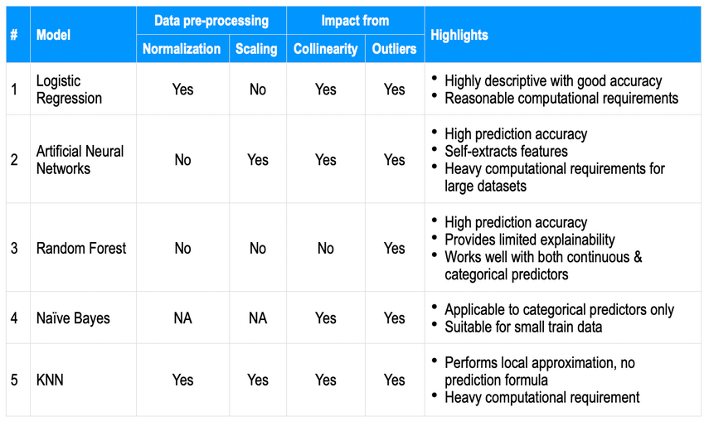
Notes:
The performance of a model is primarily dependent on the nature of the data. Given that business datasets carry multiple predictors and are complex, it is difficult to single out 1 algorithm that would always work out well. Therefore, the usual practice is to try multiple models and figure out the suitable one.
As a high-level comparison, the salient aspects usually found for each of the above algorithms are jotted-down below on a few common parameters; to serve as a quick reference snapshot.
Further, there are multiple levers e.g. data balancing, imputation, cross-validation, ensemble across algorithms, larger train dataset, etc. in addition to model hyper-parameter tuning, that may be utilized to gain accuracy. While prediction accuracy may be most desirable, the Businesses do seek out the prominent contributing predictors (i.e. a descriptive model or its resulting explainability) as well.

Slide 40
Introduction to Evaluation of Classification Model

Slide 41
Accuracy
Accuracy is the ratio of correct prediction count by total predictions made.
Is that good enough ?

Slide 42
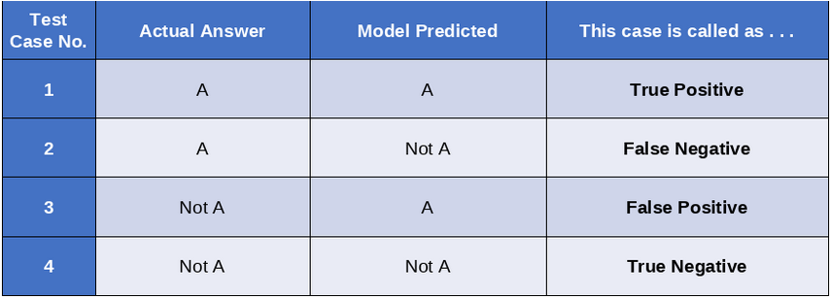
Is Accuracy a good Metric?
If the model predicts “A” as an “A”, then it is called True Positive.
If the model predicts “A” a “Not A”, then the case is called False Negative.
If the model predicts “Not A” as an “A”, then the case is called False Positive.
If the model predicts “Not A” as a “Not A”, then the case is called True Negative
For simplicity purposes, we assume a classifier which outputs whether the input alphabet is “A” or not. So, there are four distinct possibilities as shown below

Slide 43
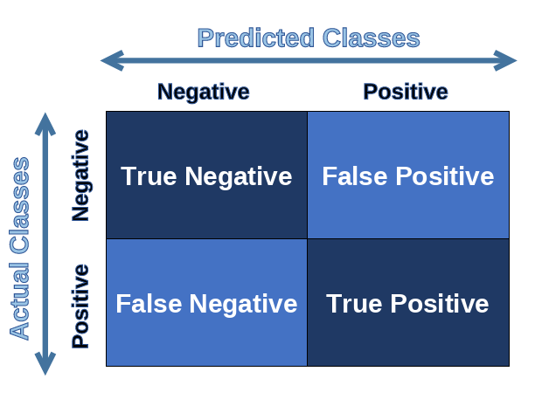
Is Accuracy a good metric?
The Accuracy metric does not represent any information about False Positive, False Negative, etc.
So, there is substantial information loss as these may help us evaluate & upgrade our model.

Slide 44
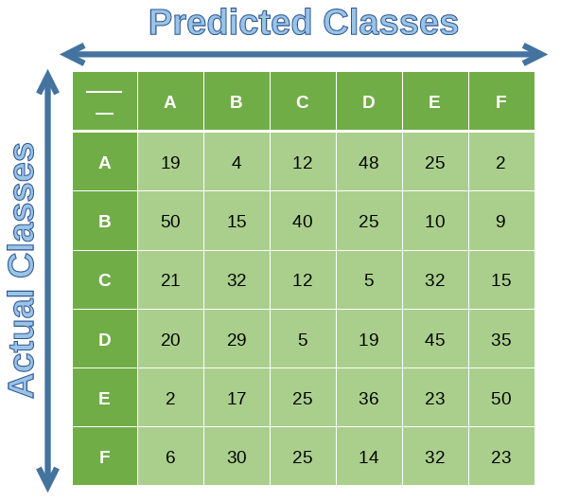
Confusion matrix
A confusion matrix is a n x n matrix (where n is the number of labels) used to describe the performance of a classification model.
Each row in the confusion matrix represents an actual class whereas each column represents a predicted class.

Slide 45
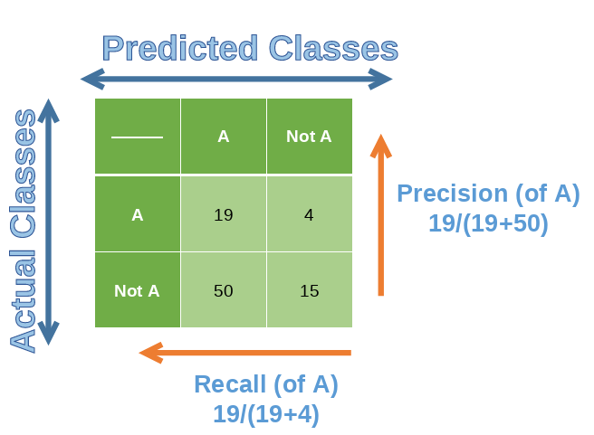
Precision
Precision
Precision is defined as the ratio of True Positives count to total True Positive count made by the model.
Precision = TP/(TP+FP)
TP=19
FP=50
Precision = 19/(19+50)

Slide 46
Precision
Precision finds that out of all that were marked as positive, how many are actually truly positive.
Use case:
Let’s take another example of a classification algorithm that marks emails as spam or not.
Here, if emails that are of importance get marked as positive, then useful emails will end up going to the “Spam” folder, which is dangerous.
Hence, the classification model which has the least FP value needs to be selected.
In other words, a model that has the highest precision needs to be selected among all the models.

Slide 47
Precision
Precision can be generated easily using precision_score() function from sklearn library.
The function takes 2 required parameters: 1) Correct Target labels 2) Predicted Target labels
## dummy example
from sklearn.metrics import precision_score
y_true = [0, 1, 1, 0, 1, 0]
y_pred = [0, 0, 1, 0, 0, 1]
precision_score(y_true, y_pred)
>>> 0.5

Slide 48
Recall or Sensitivity
Recall is defined as the ratio of True Positives count to the total Actual Positive count.
Recall = TP/(TP+FN)
TP = 19
FN = 4
Recall = 19/(19+4)
Recall is also called “True Positive Rate” or “sensitivity”.

Slide 49
Recall
Recall finds that out of all the actual real positive cases, how many were identified as positive.
Use case:
Out of all the actual Covid patients who visited the doctor, how many were actually diagnosed as Covid positive.
Hence, the classification model which has the least FN value needs to be selected.
In other words, a model that has the highest recall value needs to be selected among all the models.

Slide 50
Recall
Recall can be generated easily using recall_score() function from sklearn library.
The function takes 2 required parameters:
Correct Target labels
Predicted Target labels
## dummy example
from sklearn.metrics import recall_score
y_true = [0, 1, 1, 0, 1, 0]
y_pred = [0, 0, 1, 0, 0, 1] recall_score(y_true, y_pred)
>>> 0.333333

Slide 51


Precision vs Recall
Precision attempts to answer the following question:
What proportion of positive identifications was actually correct?
Recall attempts to answer the following question:
What proportion of actual positives was identified correctly?

Slide 52
F1 Score
F1-score combines both Recall and Precision.
It is the harmonic mean of recall & precision.
The harmonic mean is more sensitive to low values, so the F1 will be high only when both precision & recall are high.
F1 can be generated easily using f1_score() function from sklearn library. The function takes 2 required parameters 1) Correct Target labels 2) Predicted Target labels
## dummy example
from sklearn.metrics import f1_score
y_true = [[0, 0, 0], [1, 1, 1], [0, 1, 1]]
y_pred = [[0, 0, 0], [1, 1, 1], [1, 1, 0]]
f1_score(y_true, y_pred, average=None)
>>> array([0.66666667, 1. , 0.66666667])

Slide 53
F1 Score
Use case:
Let’s take an example where we must give equal importance to both the classes – classify an email as Spam and non-Spam.
Let’s assume that the model was trained only a highly imbalanced training dataset.
Here, Spam is “positive” and non-Spam is “negative” and the training dataset was 90% spam emails and 10% non-spam emails.
A model with high accuracy will know to correctly identify all the spam emails but will have trouble identifying non-spam emails.
Hence, a lot of important emails will end up going to the spam folder.
But if we select a model that has a high F1 score, it will perform better in classifying non-spam from spam.

Slide 54
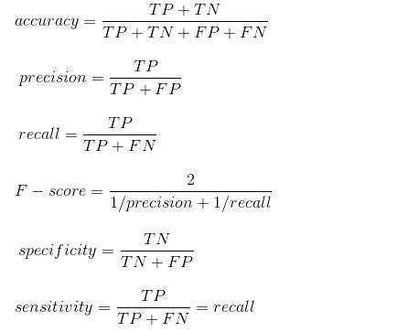
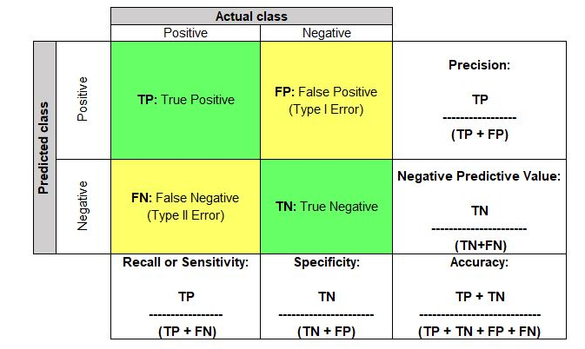
Evaluation Metrics

Slide 55
Ideal Recall or Precision
We can play with the classification model threshold to adjust recall or precision.
In reality, there is no ideal recall or precision.
It all depends on what kind of classification task is it.
For example, in the case of a cancer detection system, you’ll prefer having high recall & low precision.
Whereas in the case of an abusive word detector, you’ll prefer having high precision but low recall.

Slide 56
Precision/Recall Trade-off
Increasing recall will decrease precision & vice versa.
This is called Precision/Recall Trade-off.

Slide 57
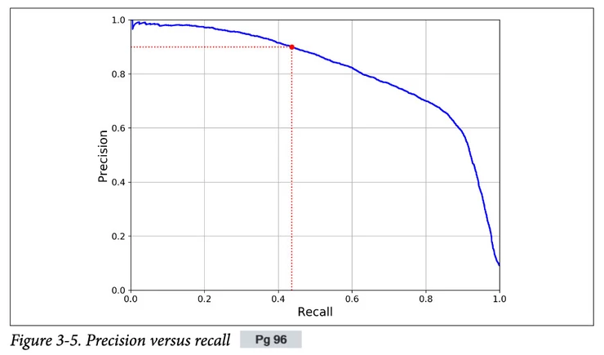
Precision/Recall Trade-off
One way to represent the Precision/Recall trade-off is to plot precision against recall directly.
This can help you to pick a sweet spot for your model.

Slide 58
Python Code
Python:
classification_report()
print(classification_report(y_true, y_pred, target_names=target_names))
precision recall f1-score support
class 0 0.50 1.00 0.67 1
class 1 0.00 0.00 0.00 1
class 2 1.00 0.67 0.80 3
accuracy 0.60 5
macro avg 0.50 0.56 0.49 5
weighted avg 0.70 0.60 0.61 5

Slide 59
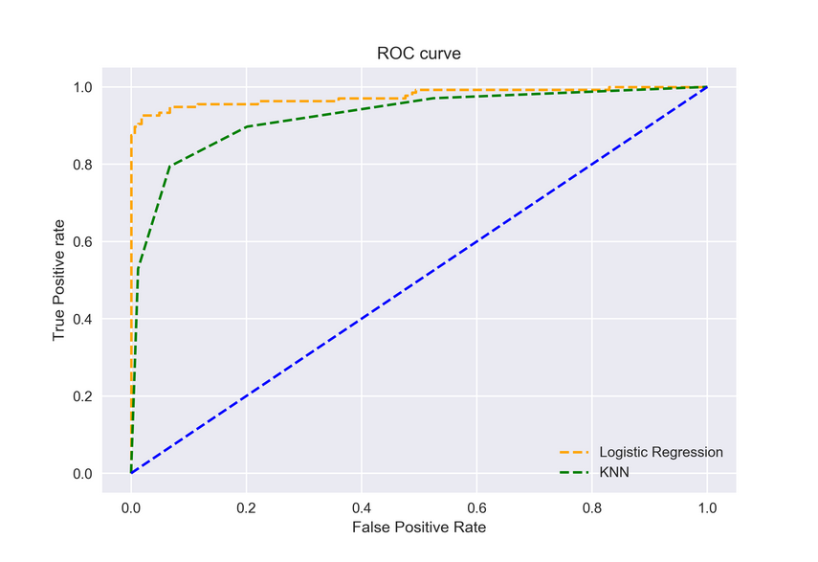
ROC Curve for Evaluation of Classification Model
ROC stands for Receiver Operating Characteristics.
It is a graph of True Positive Rate (TPR) vs False Positive Rate(FPR) (separates the ‘signal’ from the ‘noise’). 1. TPR means recall. 2. FPR is the ratio of Negative classes inaccurately being classified as positive.
TPR=TP/(TP+FN) FPR = FP/(FP+TN)

Slide 60
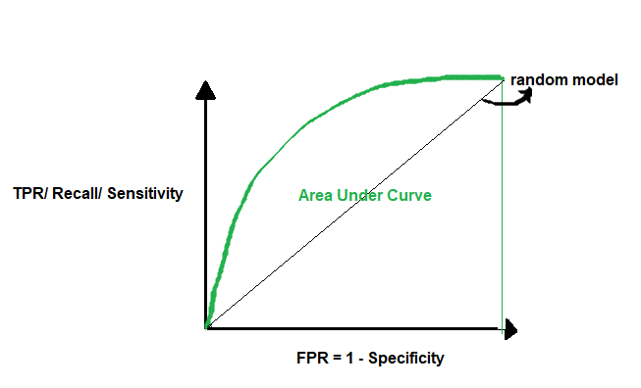
AUC for Evaluation of Classification Model
The Area Under the Curve (AUC) is the measure of the ability of a classifier to distinguish between classes and is used as a summary of the ROC curve.
The higher the AUC, the better the performance of the model at distinguishing between the positive and negative classes.

Slide 61
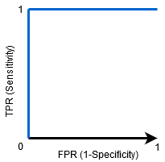
AUC for Evaluation of Classification Model
AUC = 1, then the classifier is able to perfectly distinguish between all the Positive and the Negative class points correctly.
AUC =0, then the classifier would be predicting all Negatives as Positives, and all Positives as Negatives.

Slide 62
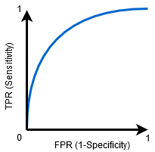
AUC for Evaluation of Classification Model
0.5<AUC<1, there is a high chance that the classifier will be able to distinguish the positive class values from the negative class values.

Slide 63
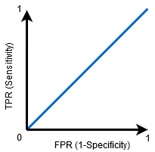
AUC for Evaluation of Classification Model
AUC=0.5, then the classifier is not able to distinguish between Positive and Negative class points.
Meaning either the classifier is predicting random class or constant class for all the data points.

Slide 64
References
https://www.analyticsvidhya.com/blog/2020/11/popular-classification-models-for-machine-learning/
https://www.analyticsvidhya.com/blog/2021/12/evaluation-of-classification-model/
https://www.analyticsvidhya.com/blog/2020/06/auc-roc-curve-machine-learning/
https://developers.google.com/machine-learning/crash-course/classification/precision-and-recall
https://www.simplilearn.com/tutorials/machine-learning-tutorial/classification-in-machine-learning
https://www.analyticsvidhya.com/blog/2021/09/a-complete-guide-to-understand-classification-in-machine-learning/

